Slide 1
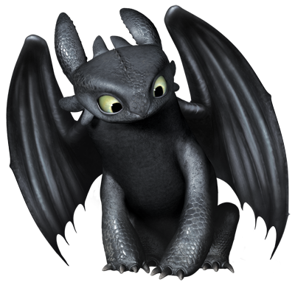

Let’s Tame a Dragon!!
Tom Van Doorslaer, Fiddle
June 30, 2017

Slide 2

Let’s Tame a Dragon!! I mean a mobile app
Tom Van Doorslaer, Fiddle
June 30, 2017

Slide 3
A long LONG time ago
Let’s slay a Dragon
The Beast
The Hero
A Princess?
The Quest
Treasure!

Slide 4
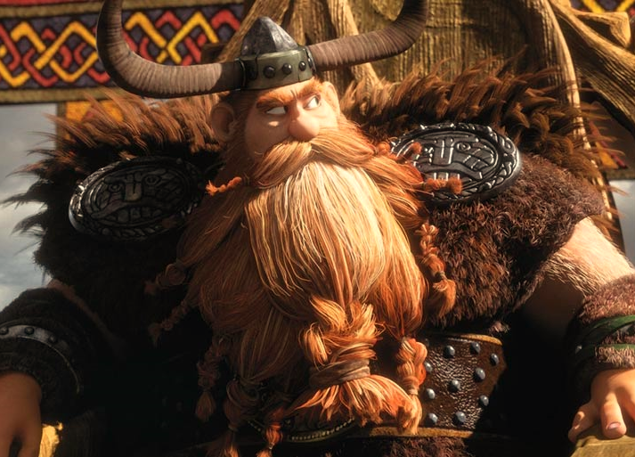
A wise ruler
I must protect my people!

Slide 5
The three musketeers components
Central instance
Messaging
Agents

Slide 6
The three musketeers components
Central instance
Log of sightings
Submission forms
Messaging
Agents

Slide 7
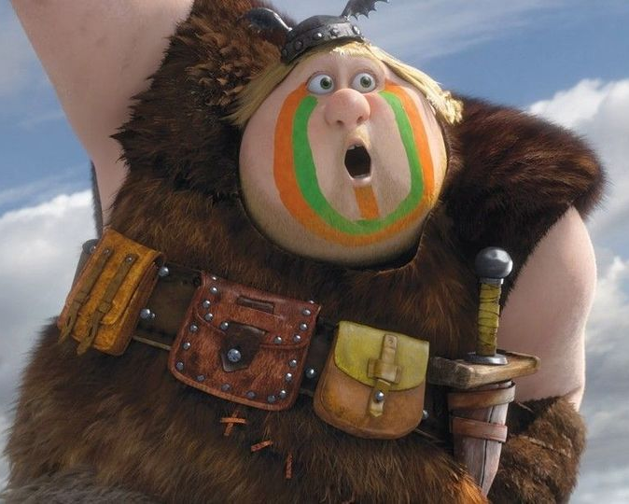
The three musketeers components
Central instance
Messaging
Agents

Slide 8
The three musketeers components
Central instance
Log of sightings
Submission forms
Messaging
Detect and report
Agents

Slide 9
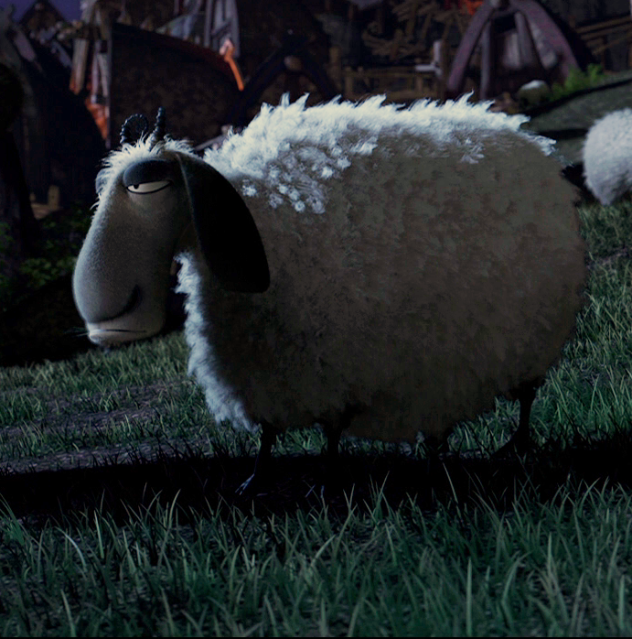
The three musketeers components
Central instance
Messaging
Agents

Slide 10
The three musketeers components
Central instance
Log of sightings
Submission forms
Messaging
Detect and report
Agents
Recent sightings
Submission forms
Stealth

Slide 11

The three musketeers components
Central instance
Messaging
Agents

Slide 12
The three musketeers components
Central instance
Data model
API
Messaging
Change detection
Agents
Data model
API
UI
What SAP Does

Slide 13
The three musketeers components
Central instance
Data model
API
Messaging
Change detection
Agents
Data model
API
UI
Offline plugin
Big, Bulky, Unpractical
Meh…
Wait, what? Frontend API?
Build it yourself
UI5 is Awesome!

Slide 14
Really, we can do better
Let’s slay a Dragon
The Beast
The Hero
A Princess?
The Quest
Treasure!

Slide 15
The three musketeers components
Offline model using indexedDB
Central instance
Data model
API
Messaging
Change detection
Agents
Data model
API
UI
Timesliced data
No middleware!
Business objects
Still Build it yourself
UI5 is still Awesome!

Slide 16
From a kingdom far far away
Let’s slay a Dragon
The Beast
The Hero
A Princess?
The Quest
Treasure!

Slide 17
The three musketeers components
Offline model using indexedDB
Backend
Data model
API
Synchronization
Change detection
Frontend
Data model
API
UI
Timesliced data
No middleware!
Business objects
Still Build it yourself
UI5 is still Awesome!

Slide 18
Timesliced tables
In a CRUD-model, 1 object is represented by 1 entry in a table
This record can be read, changed and removed, or a new object created

Slide 19
Timesliced tables
In a Timesliced CR-Model, an object is represented by a set of records, which each represent a change at a certain time.
A new change can be added, or a delete record inserted

Slide 20
Timesliced tables
Id | Timestamp | received_on_server | Name | Type | …
1 | 20170101143510 | 20170103000000 | Smag | Drag

Slide 21
Timesliced tables
Id | Timestamp | received_on_server | Name | Type | …
1 | 20170101143510 | 20170103000000 | Smag | Drag
1 | 20170101143615 | 20170103000000 | null | Dragon
1 | 20170101143615 | 20170103000000 | Smag | Dragon

Slide 22
Timesliced tables
Id | Timestamp | received_on_server | Name | Type | …
1 | 20170101143510 | 20170103000000 | Smag | Drag
1 | 20170101143615 | 20170103000000 | null | Dragon
1 | 20170101153000 | 20170103000000 | Smaug | Null
1 | 20170101153000 | 20170103000000 | Smaug | Dragon

Slide 23
Timesliced tables
Id | Timestamp | received_on_server | Name | Type | status
1 | 20170101143510 | 20170103000000 | Smag | Drag
1 | 20170101143615 | 20170103000000 | null | Dragon
1 | 20170101153000 | 20170103000000 | Smaug | Null
1 | 20170101153000 | 20170115000000 | null | Null | Tamed
1 | 20170101153000 | 20170115000000 | Smaug | Dragon | Tamed

Slide 24
Timesliced tables
No locking issues!
No data conflicts!
Change documents included
Undo!
Review/approve/reject
API’s become super simple!

Slide 25
The three musketeers components
Offline model using indexedDB
Backend
Data model
API
Synchronization
Change detection
Frontend
Data model
API
UI
Timesliced data
No middleware!
Business objects
Still Build it yourself
UI5 is still Awesome!

Slide 26
You’ll want her number
Let’s slay a Dragon
The Beast
The Hero
A Princess?
The Quest
Treasure!

Slide 27
Offline BusinessObjectModel
First, a little rant: What is a Model?
A model contains data and business logic
But in a webservice, the logic is on the server

Slide 28
Offline BusinessObjectModel
It’s offline! Using IndexedDB
It automagically stores all entries in a local IndexedDB, upon sync
Using changeRecords (remember timeslices?)

Slide 29
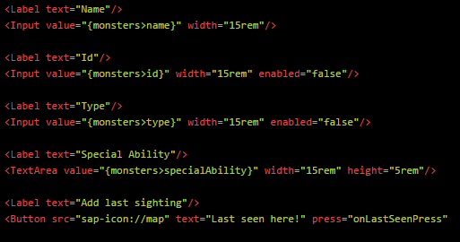
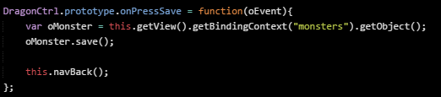
Offline BusinessObjectModel
Every entry, is actually an object instance
It acts like a silly JSON entry
But is really a business object

Slide 30

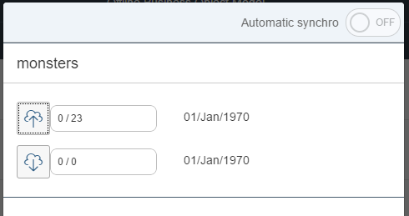
Offline BusinessObjectModel
And it has built-in sync

Slide 31
I saw a Dragon!
Let’s slay a Dragon
The Beast
The Hero
A Princess?
The Quest
Treasure!

Slide 32
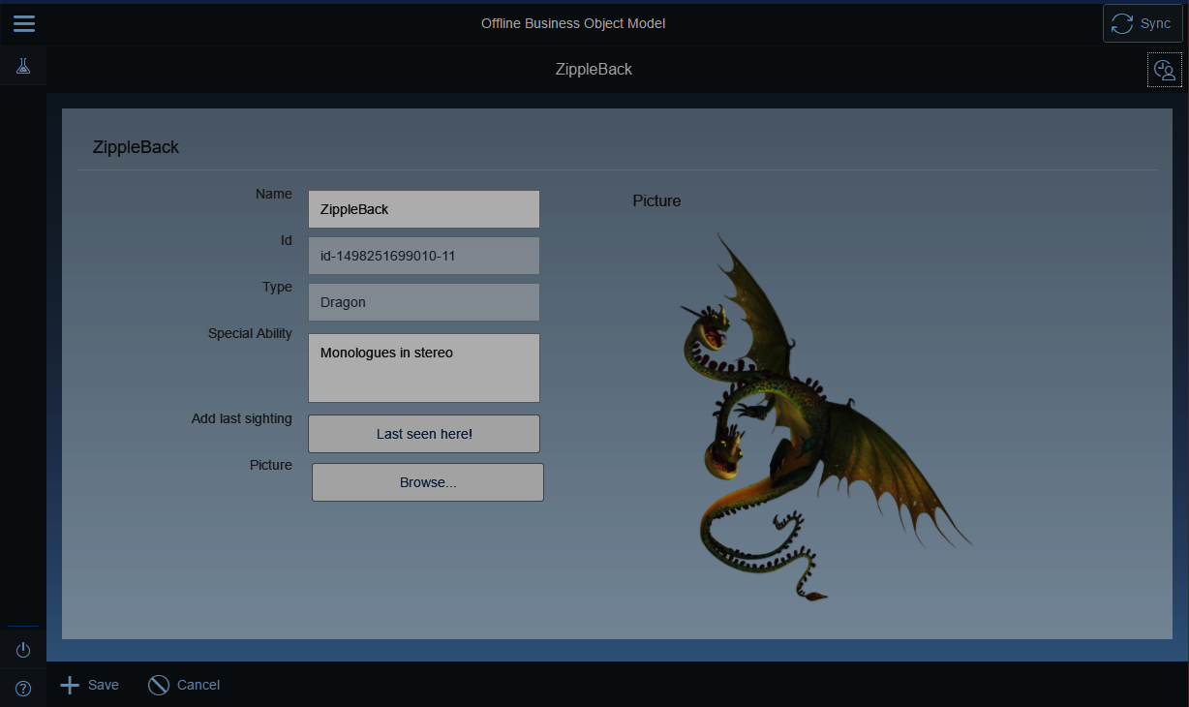
How to spot a dragon

Slide 33
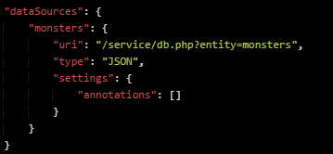
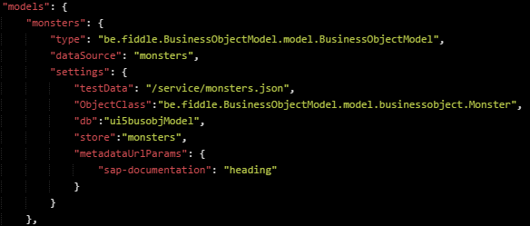
How to spot a dragon
First, you need a Monster model

Slide 34
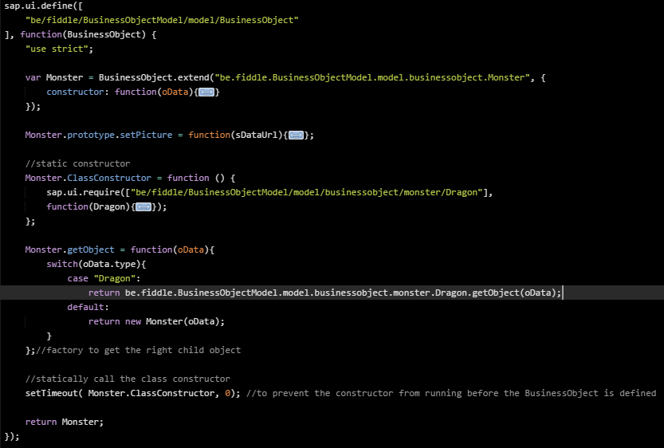
How to spot a dragon
In essence, a Dragon is a monster, so start by defining a monster
The getObject factory will provide the right monster type

Slide 35
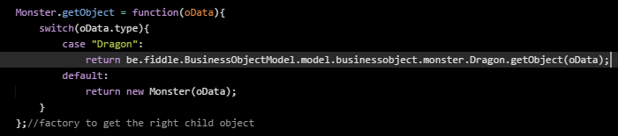
How to spot a dragon
In essence, a Dragon is a monster, so start by defining a monster
The getObject factory will provide the right monster type

Slide 36
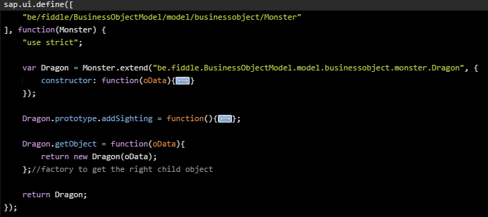
How to spot a dragon
Then, define your dragon

Slide 37
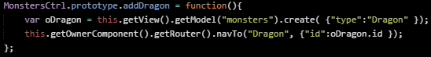
How to spot a dragon
Creating a new dragon, is easy.
.create
Controller
BusinessObjectModel
.getObject
Monster
.getObject
Dragon

Slide 38
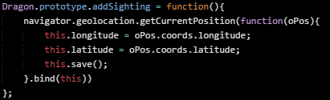
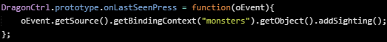
How to spot a dragon
Adding a sighting to the dragon:

Slide 39
How to spot a dragon
Adding a sighting to the dragon:
Controller
.getObject
BusinessObjectModel
.addSighting
Dragon

Slide 40
Every Dragon has Treasure
Let’s slay a Dragon
The Beast
The Hero
A Princess?
The Quest
Treasure!

Slide 41
Resources
http://businesobjectmodel.fiddle.be (Yes, I made a typo in the domainname)
{ User: Monster_doctor , pass: ILoveSAP }
https://github.com/FiddleBe/UI5-BusinessObjectModel
http://fiddle.be (For a couple of other cool UI5 custom controls with alternative input)
And yes, I still have to package it all into a be.fiddle.library
Whitepaper on Timesliced date in SAP ER On Hana: https://netorg689932-my.sharepoint.com/personal/tom_vandoorslaer_fiddle_be/_layouts/15/guestaccess.aspx?docid=1abdbd995b4da4343985c7ada31e26158&authkey=AZaMtX7PMyalLKMSC0ntwvM

Slide 42
Innocence was lost

Slide 43
Windows Mobile
Edge Mobile doesn’t fully support indexedDB
Edge Mobile doesn’t support Fiori well
Fiori Client on Windows mobile uses Edge engine
There’s no chrome, firefox or opera on windows Mobile

Slide 44
Windows Mobile
Edge Mobile doesn’t fully support indexedDB
Edge Mobile doesn’t support Fiori well
Fiori Client on Windows mobile uses Edge engine
There’s no chrome, firefox or opera on windows Mobile
Yesterday morning, I went shopping. For an Android Phone.

Slide 45
To be Continued

Slide 46
Next steps
Bugs—
Make it work on Windows Mobile!
Figure out Automatic Sync
Publish be.fiddle.library
Introduce serviceworkers and make it a truly Progressive Web App
Ditch PHP & MySQL in favour of Hana eXpress
[Offline, Gestures, Eye tracking, AR goggles].Combine().catch( oDragon )
Give another preso at UI5Con year++

Slide 47

Thank you.
Contact information:
Tom Van Doorslaer
@TomVanDoo
Fiddle.be
You are welcome to give feedback for this session
in the UI5con Event App
Which does not exist for Windows Mobile!!

